Slide 1
2021
tmwi.
Raja Workplace European Agency Awards
tmwi.co.uk | hello@tmwi.co.uk | 01789 404 180 PRIVATE & CONFIDENTIAL. NO UNAUTHORISED REPRODUCTION.

Slide 2
HEADLINE RESULTS
29
Pieces of coverage
313M
Online readership
393K
Est. coverage views
18
Links from coverage
39
Average domain authority
720
Total domain authority

Slide 3
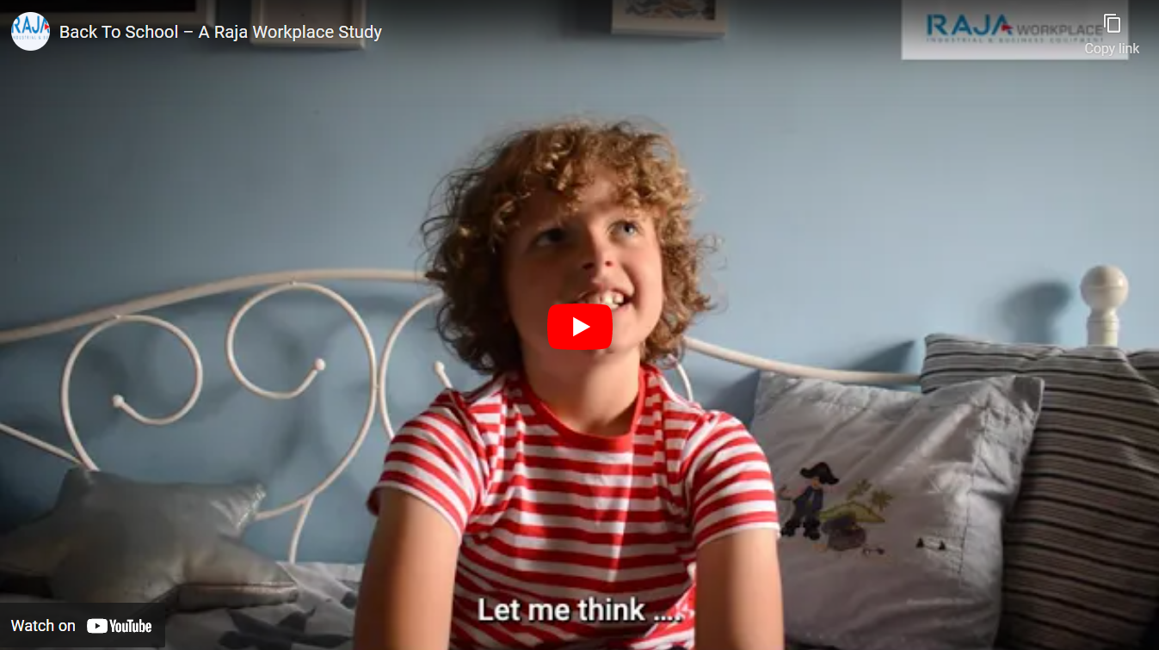
VIDEO CONTENT
https://www.youtube.com/watch?v=jP4nYeD482A

Slide 4
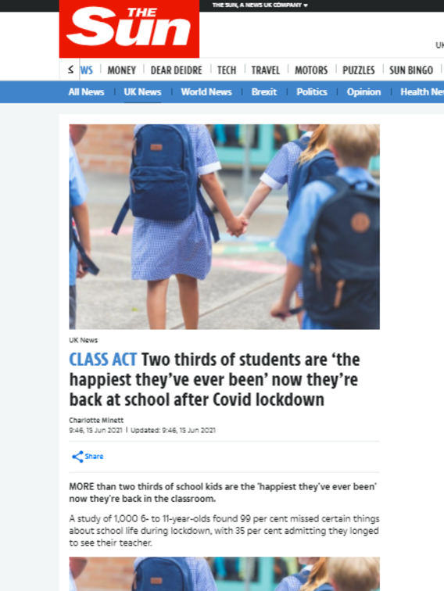
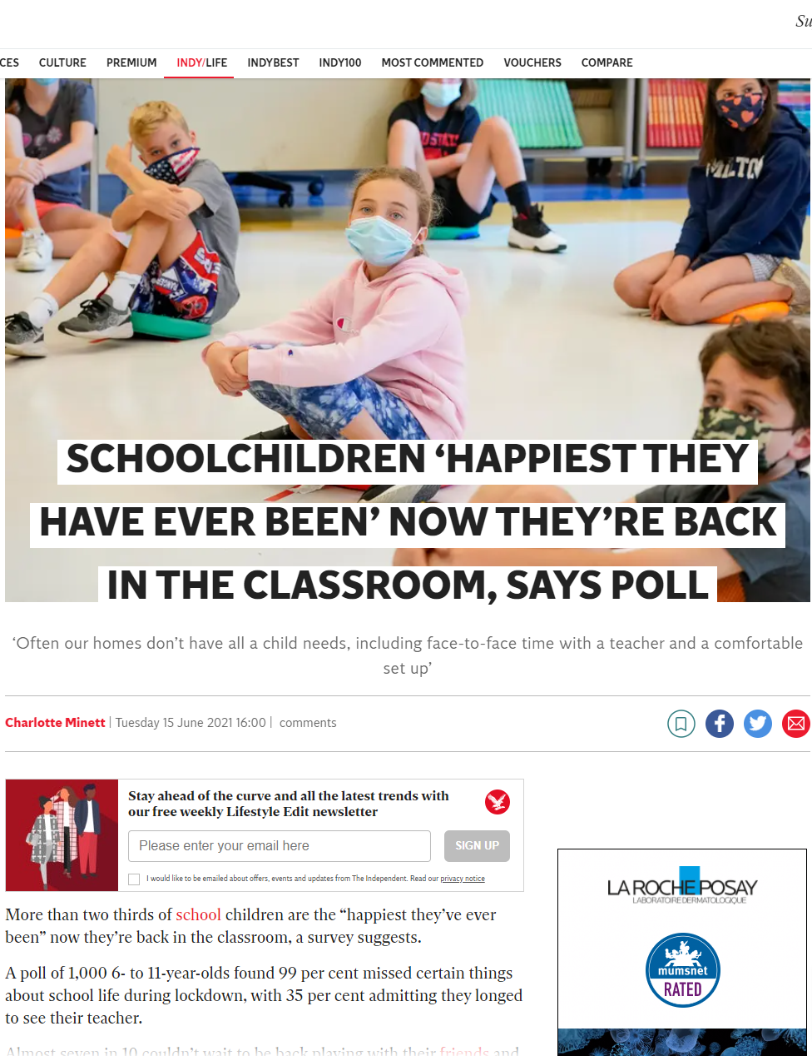
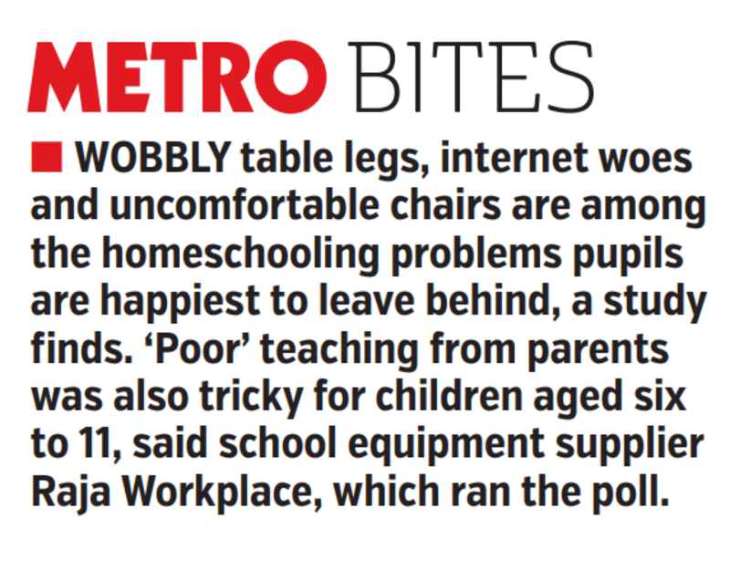
PRESS CLIPPINGS

Slide 5
EDUCATION SPECIALISTS COVERAGE

Slide 6
WIDER ONLINE COVERAGE

Slide 7
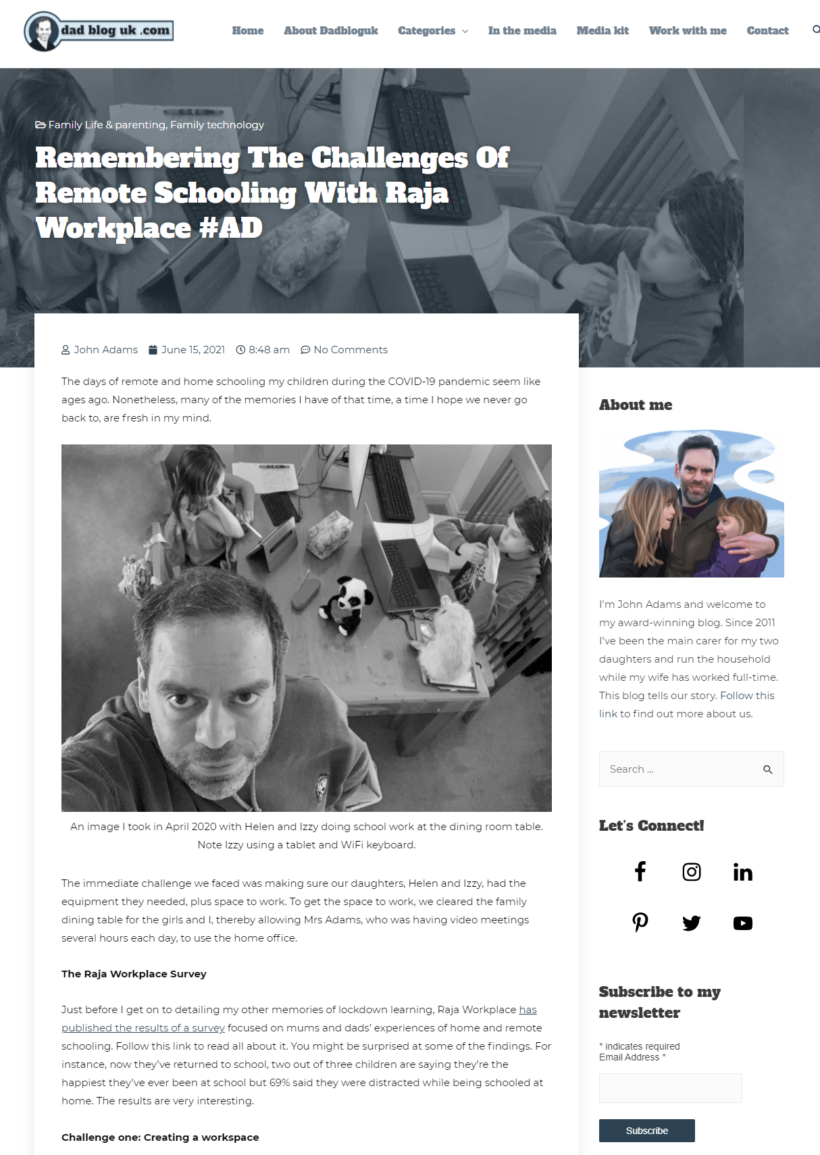
INFLUENCER & PARENTING BLOGGER CONTENT

Slide 8
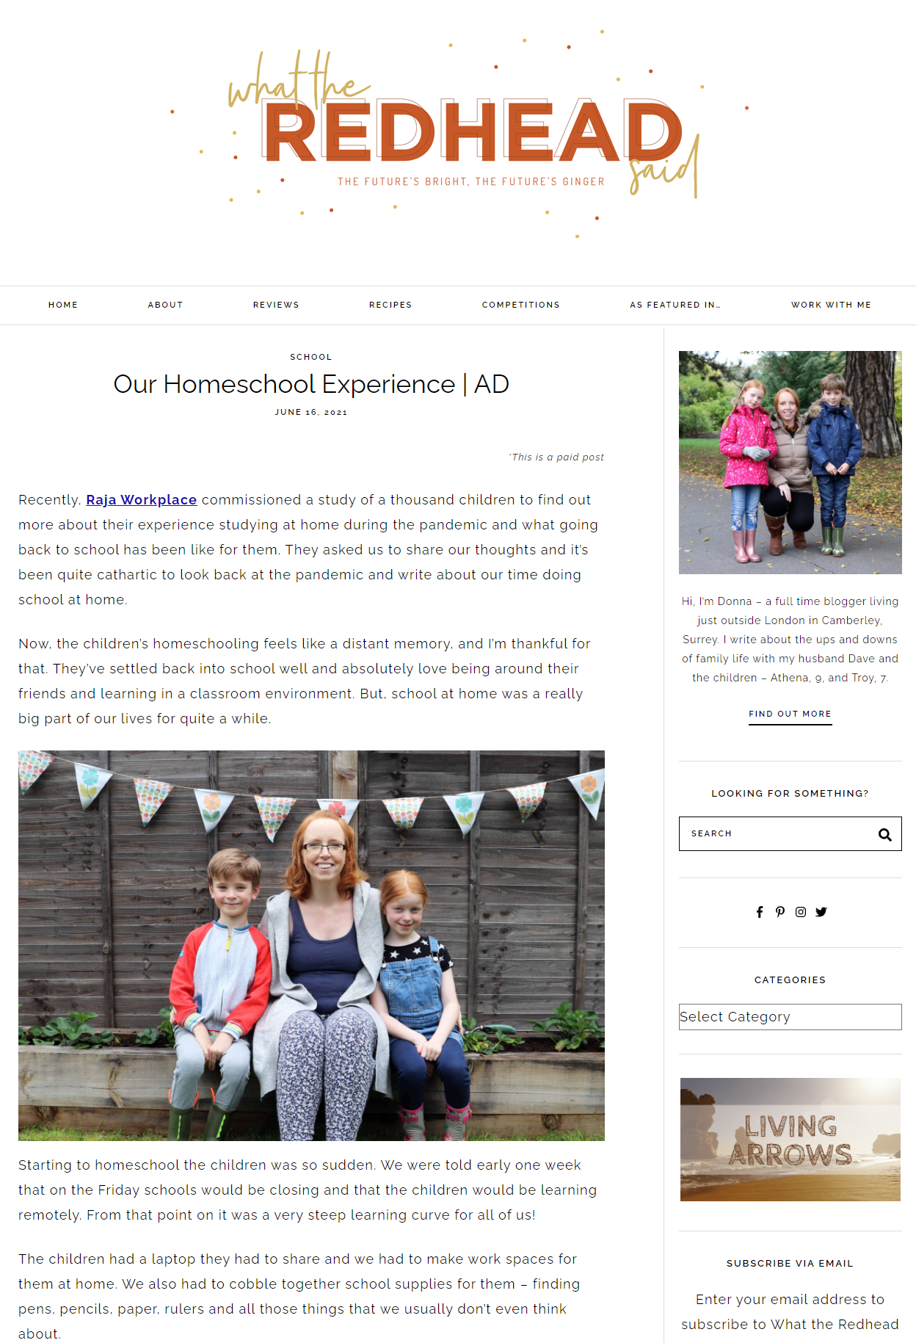
INFLUENCER & PARENTING BLOGGER CONTENT

