Slide 1
2021
tmwi.
Nescafe Eu Agency Awards
tmwi.co.uk | hello@tmwi.co.uk | 01789 404 180 PRIVATE & CONFIDENTIAL. NO UNAUTHORISED REPRODUCTION.

Slide 2
AUDIENCE PROFILE
Online shopping for activewear (9%)
Browses for residential properties (6%)
Dominant age group: 25-34 (33%)
Likely to be a parent with a baby/toddler (2%)
In market for a car or repairing current car (14%)
58% Female
Holiday and accommodation searches (17%)
Business
Professionals
Researches for makeup, cosmetics and hair care products (4%)
Avid searcher for home and garden décor (14%)
Searching for business services on marketing and advertising (5%)
Shops for gifts online (3%)

Slide 3
AUDIENCE PROFILE

Slide 4
AUDIENCE PROFILE – NESCAFE ORIGINAL
Positive and genuine. A relatable and friendly brand that customers can engage and converse with
Down to earth, C2DE, 45+ years, recruiting into the NESCAFÉ brand
Target Customer
Brand Attributes
Brand Personality
Brand Benefits
Appreciates their ‘can-do’ attitude
Everyday coffee without the fuss, a coffee to kick start the day

Slide 5
AUDIENCE PROFILE – NESCAFE GOLD
45-65 years old, ABC1
Coffee crafted with care for moments that matter, a coffee for a time out and social treats
Target Customer
Brand Attributes
Brand Personality
Brand Benefits
A friendly and genuine brand that truly cares about their customers
High quality coffee products, made with fine ingredients, for those who want something special

Slide 6
AUDIENCE PROFILE – NESCAFE AZERA
GenX, the trend setter, early adopters, ABC1
Stimulates people, encourages them to connect with the world
Target Customer
Brand Attributes
Brand Personality
Brand Benefits
Premiumisation and youth
Diversification to upcoming coffee segments that is attractive to a younger audience

Slide 7
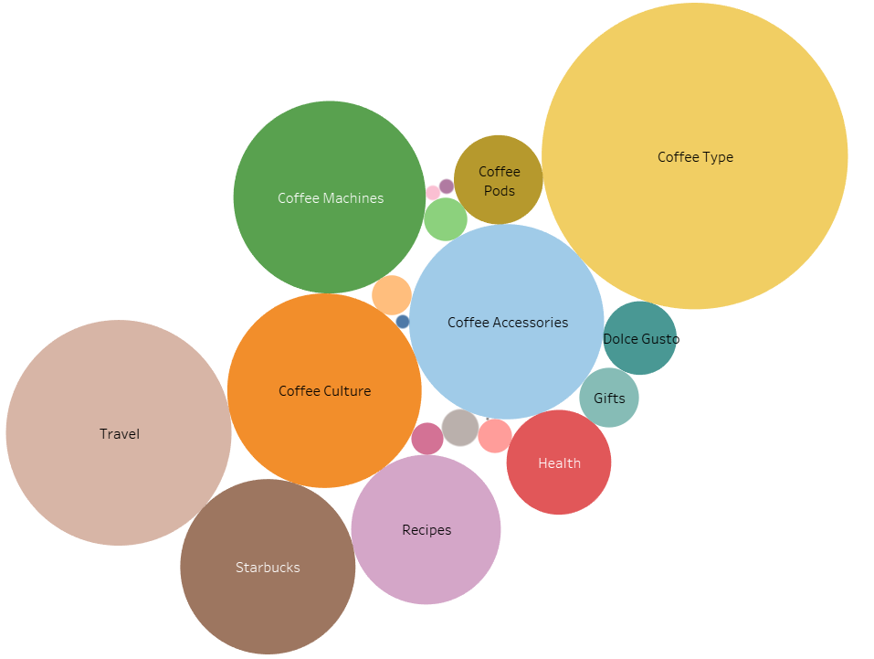
ASIM & CONTENT TERRITORIES
Beauty & Clothing
Coffee Origins
Latte Art
Coffee Accessories
Coffee Pods
Travel
Coffee Culture
Coffee Type
Offers & Sale
Coffee Events
Gifts
Recipes
Coffee Machines
Health

Slide 8
SEO PERFORMANCE UPDATE
GA Organic Performance
34% YoY increase*
(New users)
47% YoY increase*
(Sessions)
Notes:
Comparing the first six months of the year to the first 6 months of 2020, we can see a 47% YoY increase in organic sessions and a 34% YoY increase in the number of new users – the number of new users shows that more people are finding the site, which is what we wanted with our work on the ASIM
We have seen a slight dip from May – June, both years, but this is seasonal and picks back up again in July
We saw a big increases in brand search – so terms such as ‘nescafe’ and ‘nescafe coffee’, but also branded product names and category names ‘nescafe original’, and ‘nescafe gold’
If we look at last year, where the UK was in lockdown until end of June and we saw a big uptake in traffic, it’s great to see this traffic hasn’t been lost with the return to ‘normal life’ this year

Slide 9
SEO PERFORMANCE UPDATE
Keyword Rankings
131% YoY increase in overall search visibility
46% YoY increase in position 1-3
Notes:
This shows overall keyword rankings
Looking at the first 6 months of this year, compared to last, we can see a 46% YoY increase in keywords ranking in positions 1-3
And a 131% YoY increase in overall search visibility, which is just fantastic growth
It’s great to see that the website benefitted from both algorithm updates that we saw in June – first the June Core Algorithm Update at the start of the month and then the Page Experience Update that started in the middle of the month

Slide 10
SEO PERFORMANCE UPDATE
Brands
-9% YoY Increase
GOLD
+79% YoY Increase
ORIGINAL
+10% YoY Increase
AZERA
Notes:
This is the brand breakdown from the first 6 months of 2020 compared to the last 6 months of 2021
Original has seen the biggest YoY increase in traffic
And Gold is the only brand to see a YoY decrease in traffic – this is related to a decrease in traffic to product pages, rather than content

Slide 11
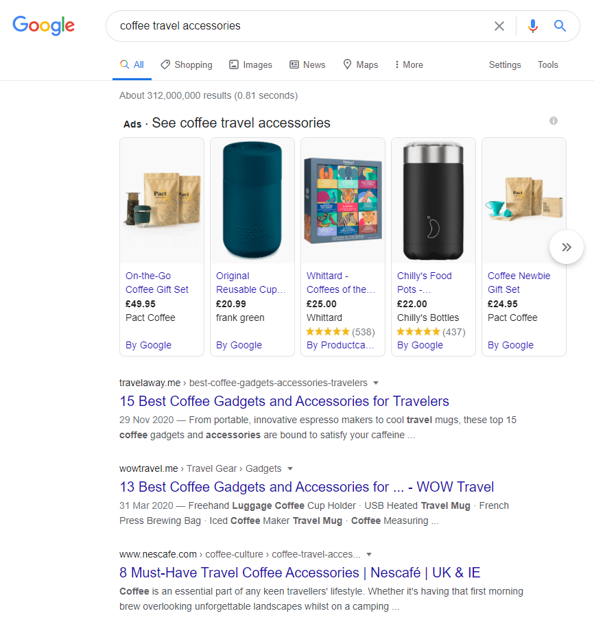
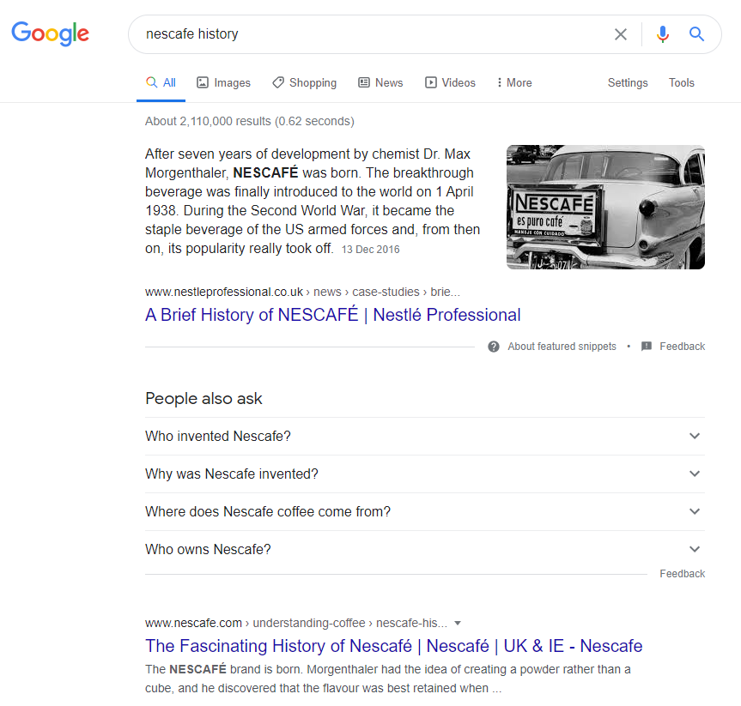
CONTENT PERFORMANCE
POSITIONS 1-3

Slide 12
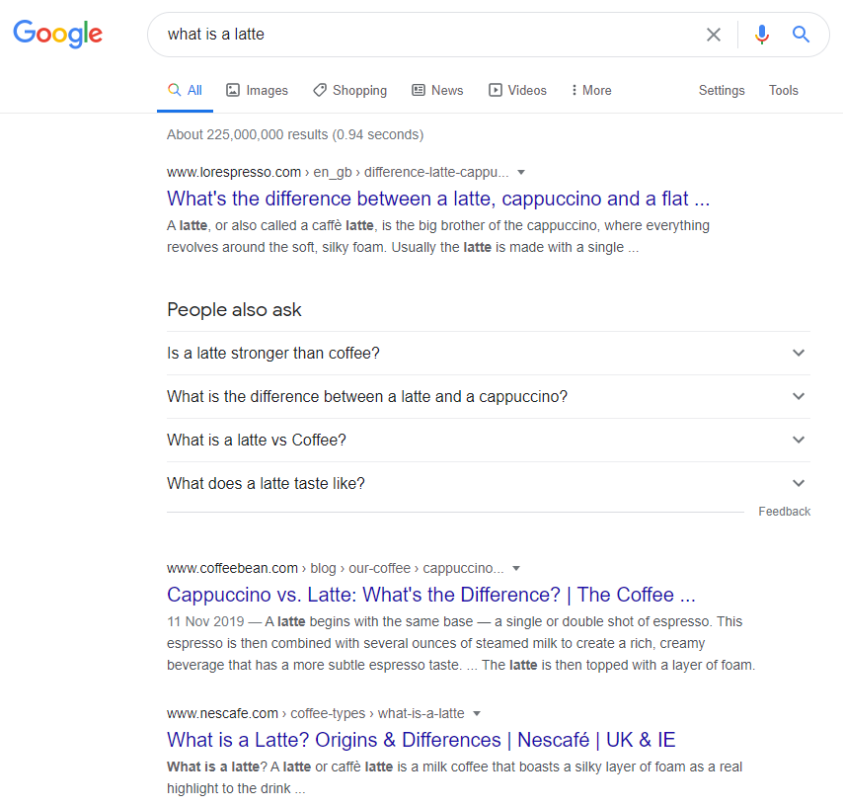
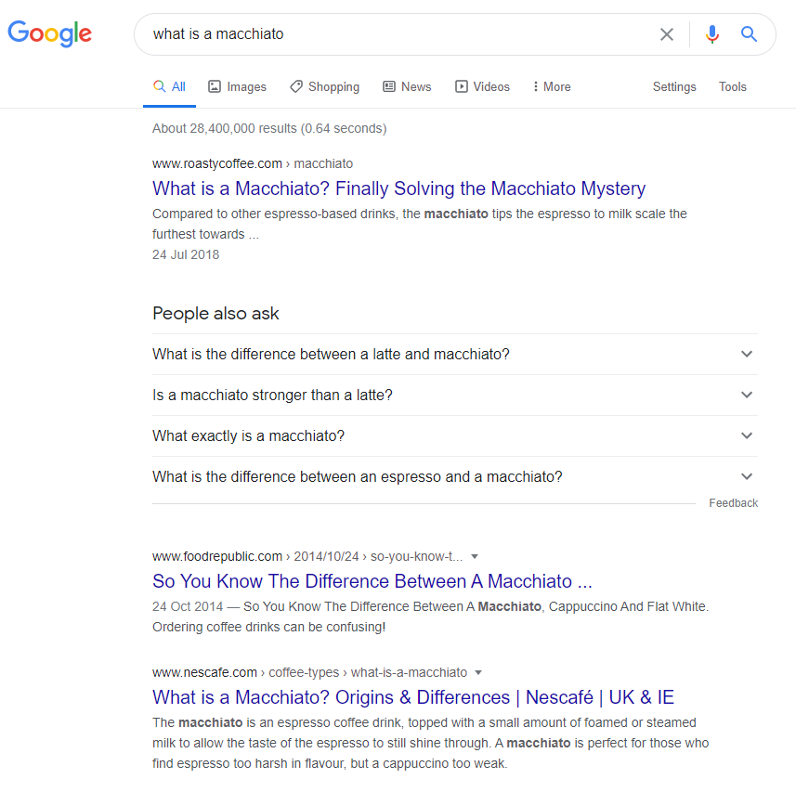
CONTENT PERFORMANCE
POSITIONS 1-3

Slide 13
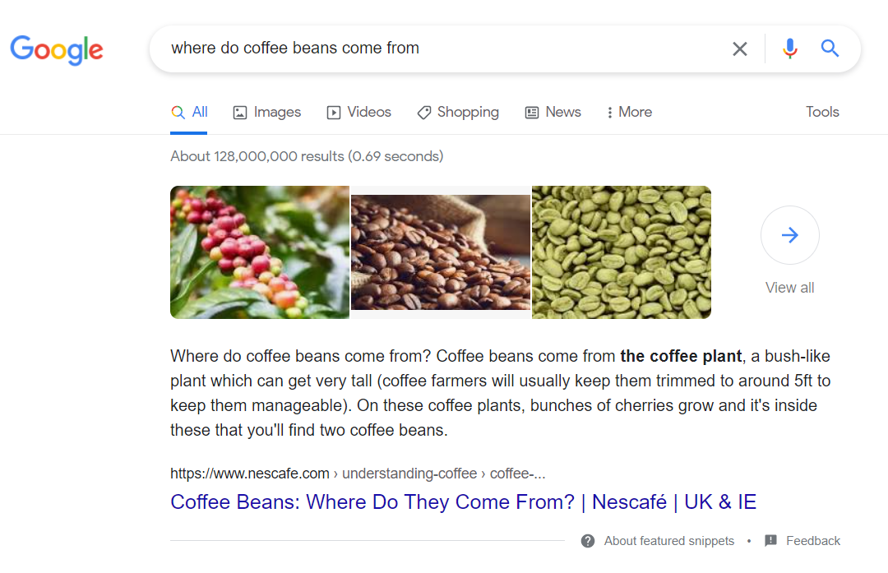
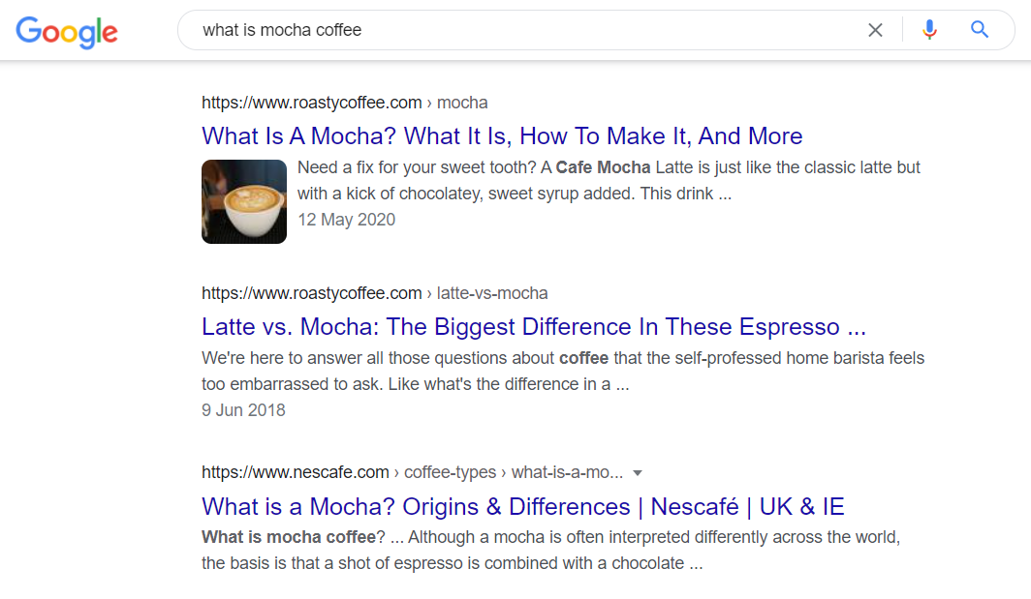
CONTENT PERFORMANCE
POSITIONS 1-3

Slide 14
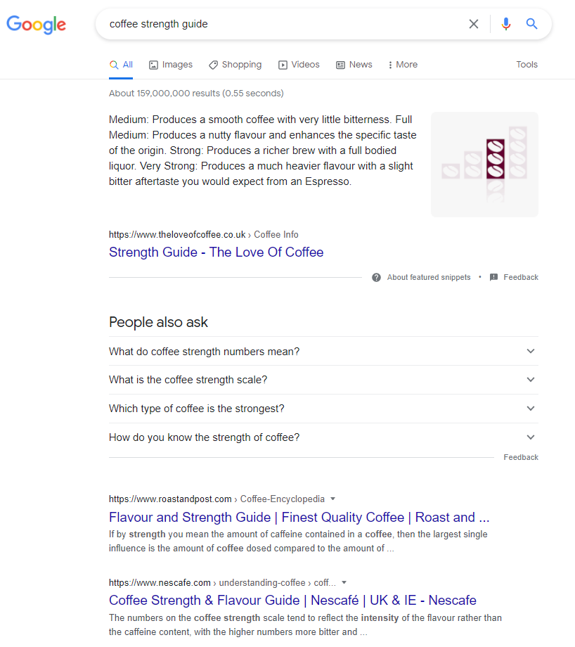
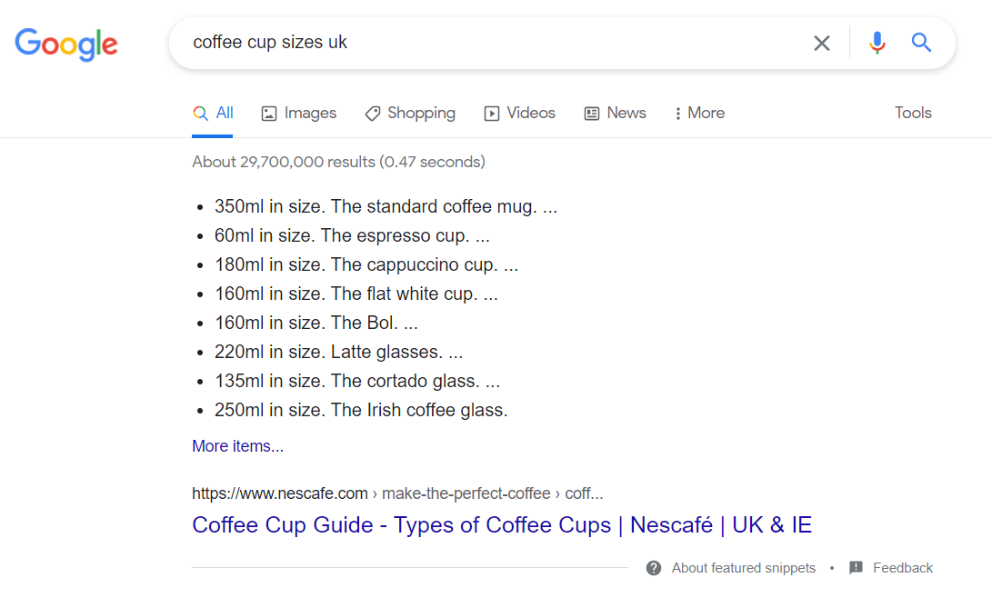
CONTENT PERFORMANCE
POSITIONS 1-3

